Slide 1
chapter 8 Security, privacy and integrity
8.2 Data integrity

Slide 2
Syllabus
describe error detection and correction measures designed to protect the integrity of data, including:
  – data validation
  – data verification for data entry
  – data verification during data transfer, including
    ○ parity check 奇偶校验
    ○ checksum check 校验和检查

Slide 3
Data validation
Data verification is a verification operation to ensure the integrity of the data. However, it does not guarantee that data is accurate.
Include：
  Presence check 有无检测
  Format check
  Length check
  Range check
  Uniqueness check 唯一性检查

Slide 4
Data validation
Presence check
A field must contain a value (it cannot be left blank).
Format check
A product code must follow a certain format.
Length check
A value must be a certain length.
Range check
A number value must be within a certain range.
Uniqueness check
The data value for an attribute数据值 cannot be repeated for other records.

Slide 5
Data verification for data entry
Some checks are set in advance to prevent users from entering wrong data. Therefore, So some errors are prevented from occurring.
For instance:
  Registering a user requires entering the same password twice.
  Some websites require passwords to contain both numbers, letters, and symbols.
  Online shopping address is generally selected in the drop-down box下拉框

Slide 6
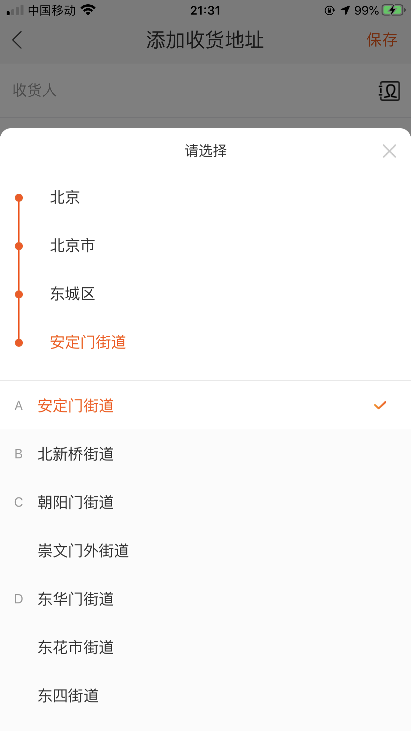
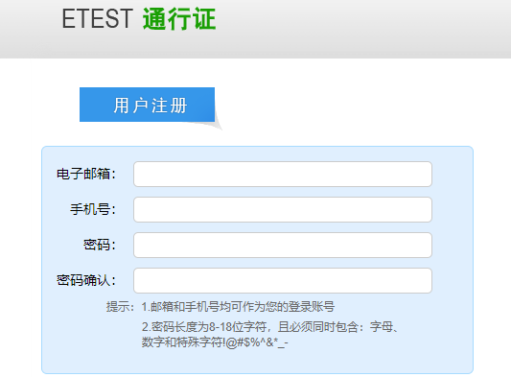
Data verification for data entry

Slide 7
Data verification during data transfer
During the transmission of data, it will be affected by various interferences干扰因素, such as pulse interference脉冲干扰, random noise interference随机噪声干扰 and human interference人为干扰, which will cause data errors. In order to be able to control errors in the transmission process, the communication system must use effective measures to control the occurrence of errors

Slide 8
Verification
Verification: Confirming that the data received by the system is integrated.
Methods:
  Checksum
  Parity check
  Parity block check

Slide 9
Checksum 校验和
Data is sent in blocks and the checksum, an additional value, is sent at the end of the block of data.
If the sum of all the bytes in the transmitted block of data is <=255, then the checksum is this value.
If the sum>255, then the checksum is using the algorithm to calculate the value.

Slide 10
Example 1
The value of X is 1185, then through the algorithm, we get:
  1185/256=4.629
  rounding down to nearest whole number gives Y=4
  Multiplying by 256 gives Z=Y*256=1024
  The difference (x-z) gives the checksum:1185-1024=161
  So the checksum=161

Slide 11
The step of checksum
When a block of data is to be transmitted, the checksum is first of all calculated.
At the receiving end接收端, the checksum is recalculated from the block of data received.
Compare the two checksum
  If they are the same, then the data was transmitted without any errors.
  If they are different, then a request is sent for retransmitting for the data.

Slide 12
Parity checking 奇偶校验
Parity checking is one method used to check whether data has been changed following transmission from one device to another device.
If there are even偶数 number of 1-bits, the system uses Even parity
If there are odd奇数 number of 1-bits, the system uses odd parity
For example
(4 1-bits) choose even parity
 | 1 | 1 | 0 | 1 | 1 | 0 | 0
Parity bit

Slide 13
Parity check(even)
At the transmitting end, the number of 1s in the seven-bit code is counted.
  If the count is even number, the parity bit is set to 0
  If the count is an odd number, the parity bit is set to 1
  This is repeated for every byte in the transmission
At the receiving end, the number of 1s in the eight-bit code is counted.
  If the count is an even number, the byte is accepted
  This is repeated for every byte in the transmission

Slide 14
Example 1
Sender’s byte
Receiver’s byte
This means a transmission error has occurred.
Can you work out which bit is incorrect?
0 | 1 | 0 | 1 | 1 | 1 | 0 | 0
0 | 1 | 0 | 0 | 1 | 1 | 0 | 0

Slide 15
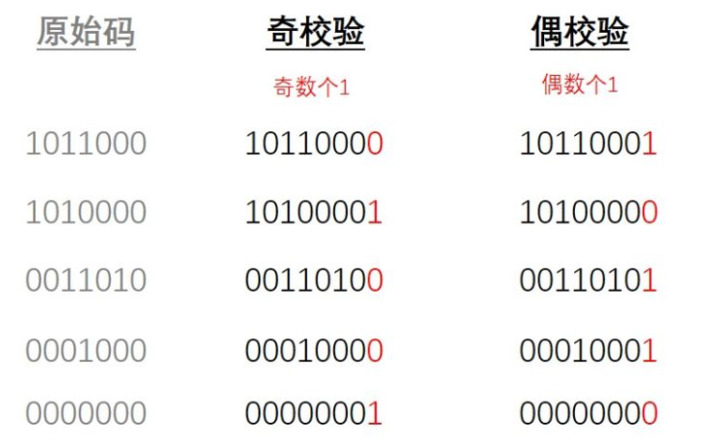

Slide 16
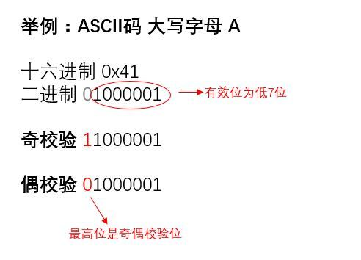
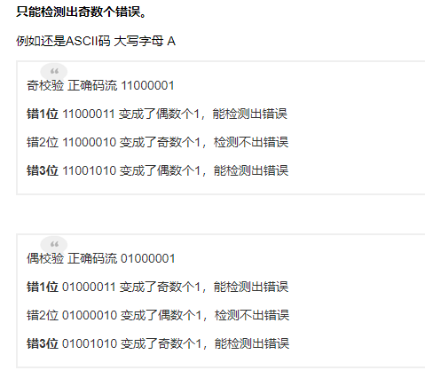

Slide 17
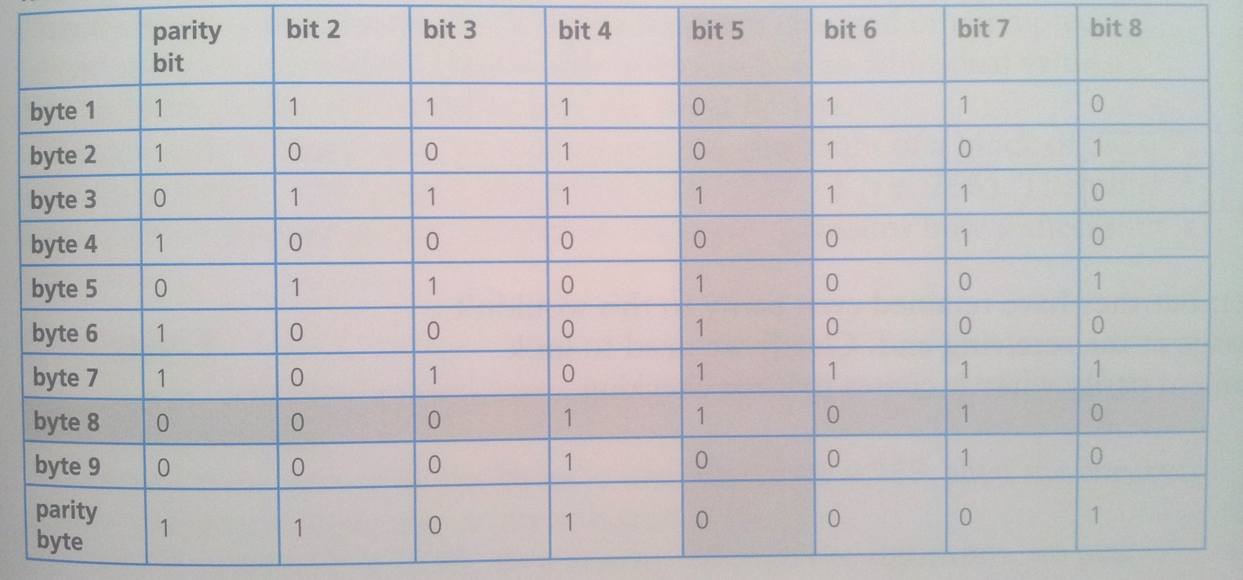
Example 2
0
Nine bytes of data have been transmitted. Even parity will be used.
Parity byte has been sent, produced by the vertical parity check, it also indicates the end of the block of data.

Slide 18
Parity block check
A parity check can be made on a group of bytes which are transmitted in sequence.
The data bytes and the parity byte together are called the parity block.
The parity byte is calculated from the vertical垂直 columns of the data bytes.
Each bit in the parity byte is calculated by using the normal parity calculation for each of the eight columns of the data bytes.

Slide 19
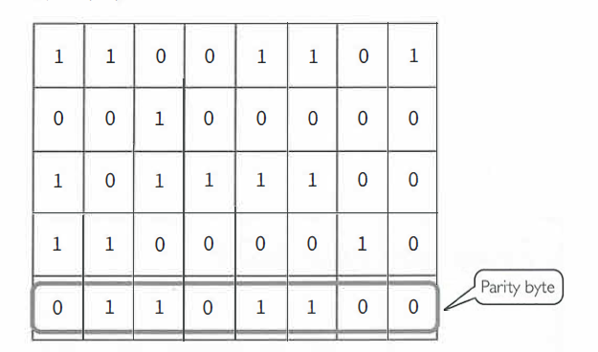
Parity block check

Slide 20
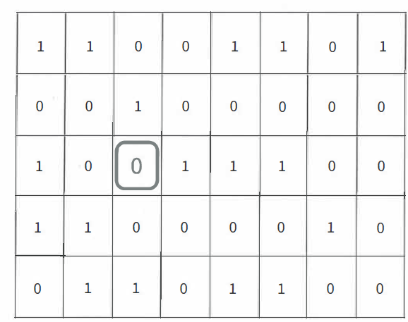
Example 1
Assume that there was an error in the bytes transmitted.

Slide 21
This error will mean the receiving software calculates the parity bit for this byte as 1 - but it was received as a 0. So, there must be an error: Also, the parity byte calculation will trigger触发 there is an error in the third column.
The software can therefore conclude that the error must be the highlighted bit and so will change this from the received 0 to a 1 .

